Slide 1

Student Name: Rasel Shikder
ID No: BBA2402032084
Department: BBA (Fall - 2024)
Section: Dua
Course Title: Computer Application in Business
Course Code: CSE 1105
Teacher: Lecturer Farjana Rahman Farin
Topic: Understandings of Artificial Intelligence
Date: Sunday, 10 November, 2024

Slide 2
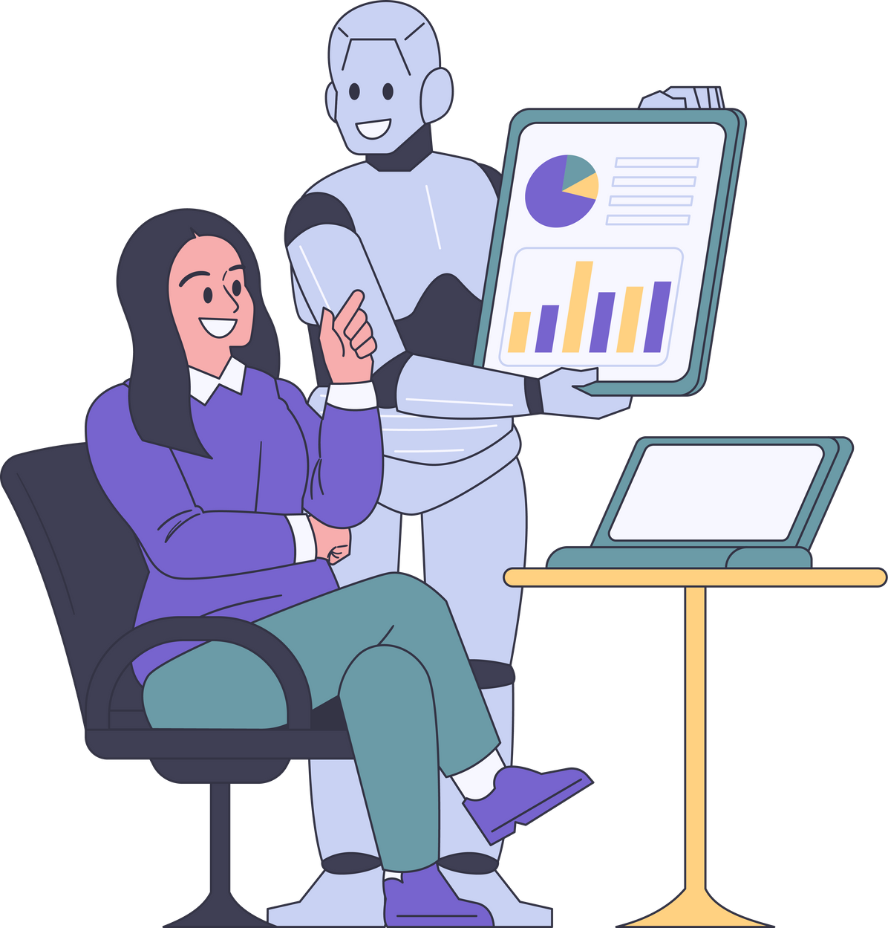
Understandings of
Artificial Intelligence
l uses in EFL

Slide 3
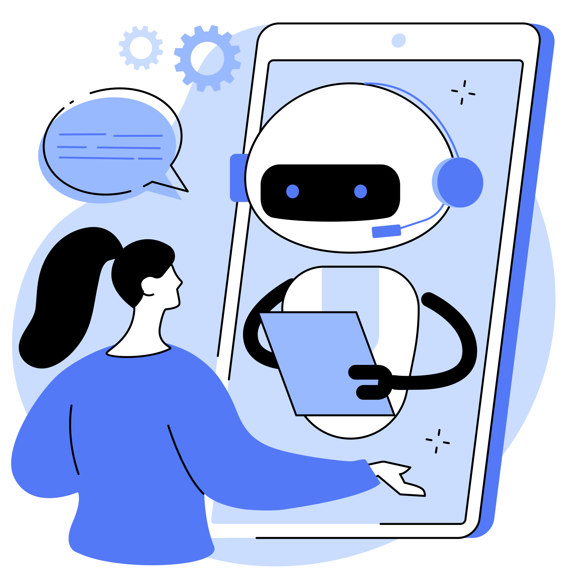
What is Artificial Intelligence?
AI is the ability of machines to perform tasks that normally require human intelligence.
Examples: Voice assistants & Search Engine recommendations
Voice assistance makes calls and open apps and Search Engine of browser makes suggestions for human.

Slide 4

Everyday uses of Artificial Intelligence
Social Media: Content recommendations in online platforms.

Slide 5
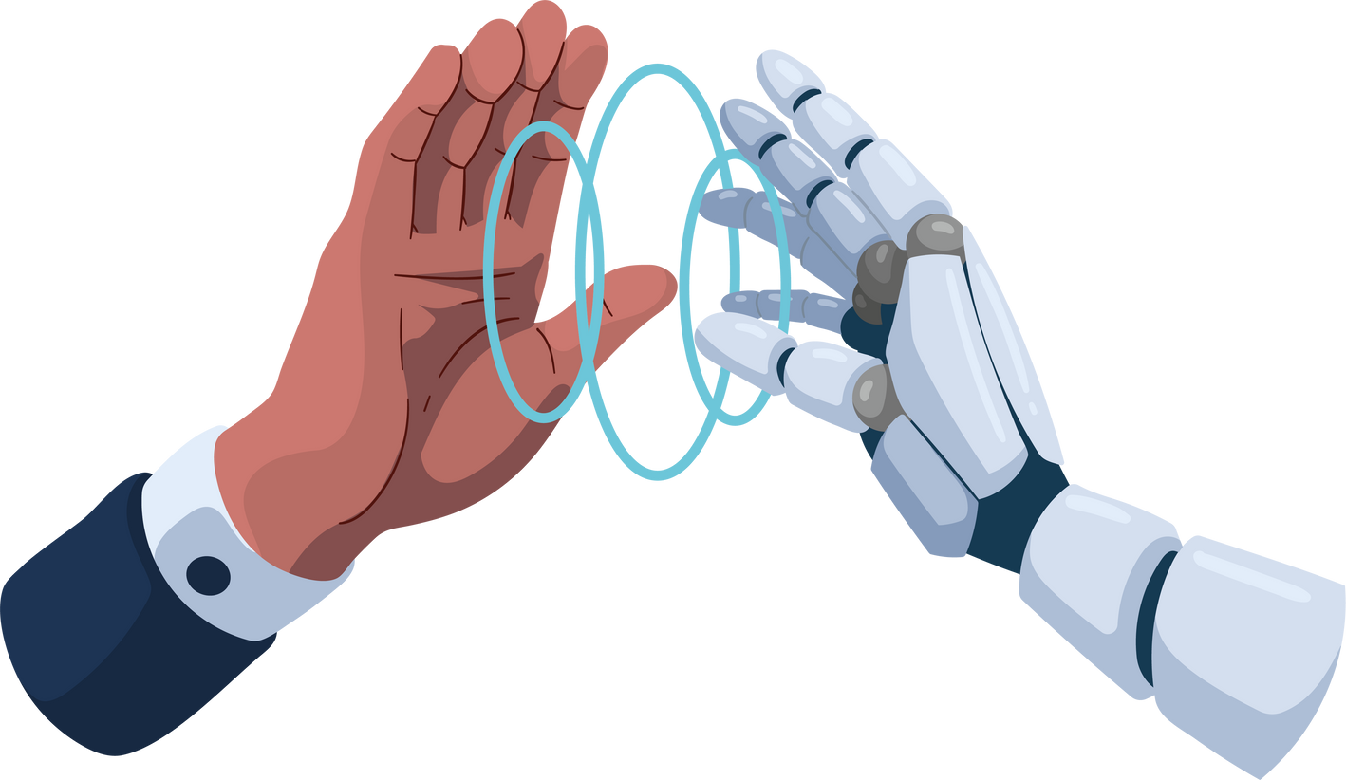
Benefits of Artificial Intelligence
After inventions of Ai Increased Humans' efficiency and productivity significantly.

Slide 6

Problems of Artificial Intelligence
While comes about the problems of AI, it causes job displacement and in some certain circumstances AI is harmful for People’s privacy.

Slide 7

Potential Future
Trends: Continuous improvement in AI capabilities.
New Innovations: AI could help tackle global issues (e.g., healthcare, climate change).

Slide 8

THANK YOU
FOR LISTENING!

